Slide 2

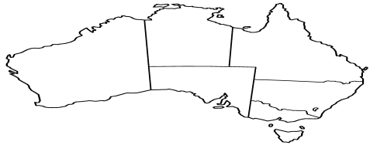
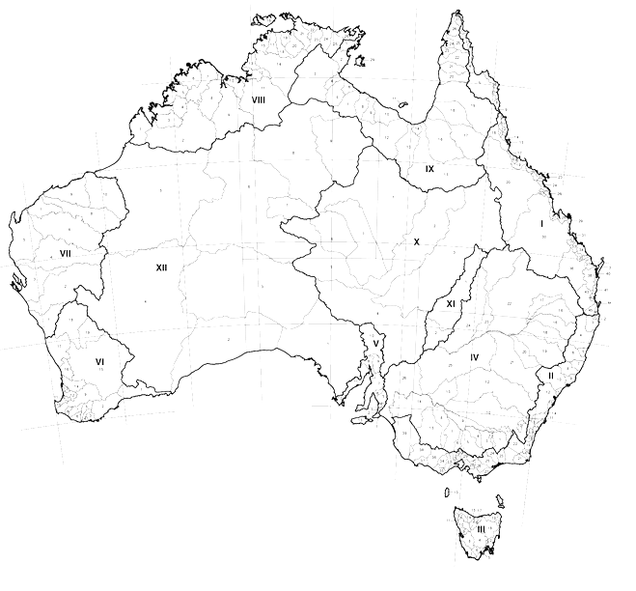
XYZ Server
Hierarchical Relationship:
- e.g., NSW (State) is parent to Albury (LGA)
Jurisdictional Units
FSDF
Topology
Local Government Units
Spatial Relationship
– e.g. NSW (State) is “adjacent” to Towong (LGA)
Spatial Relationship
– e.g. Towong (LGA) “intersects” Yackandandah (SA2)
Statistical Units
ABS
PSMA
Geometry
Data
GeoServer
(http://envirohack.research.nicta.com.au/)

Slide 3
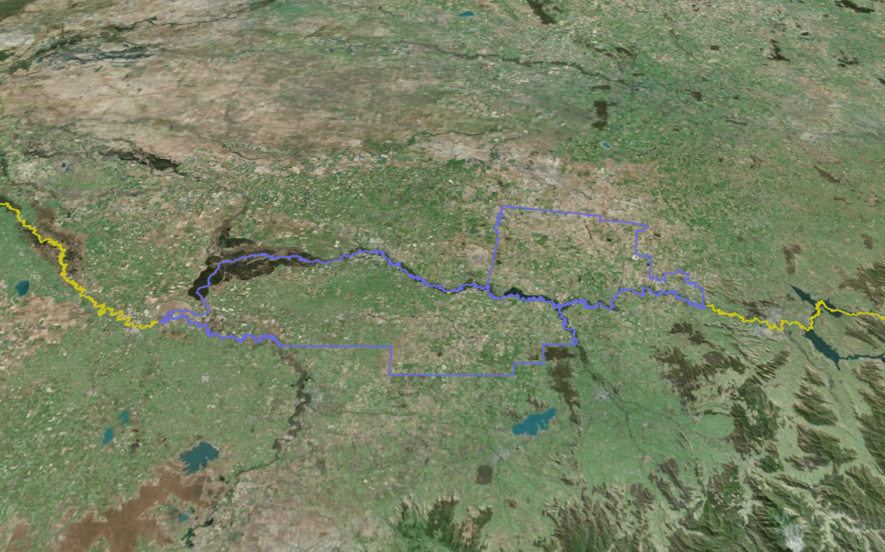
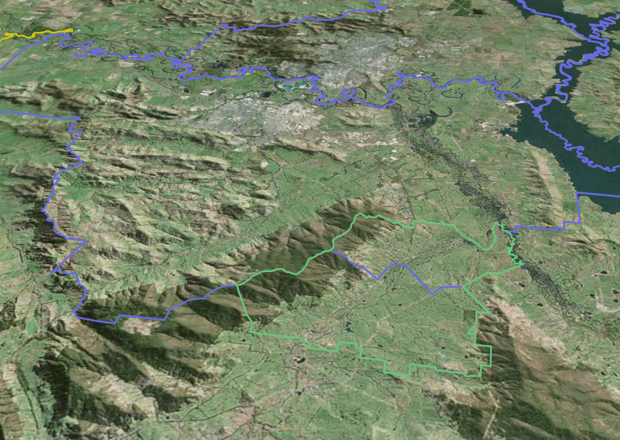
Spatial Relationship: Adjacency
Spatial Relationship: Intersection
STATE
(NSW)
LGA Y Corowa
LGA Albury
LGA X
(Moira)
SA2 Lavingtion
STATE
(VIC)

